Slide 1
Online Outpass System
TS- WEB PROJECT
Presented By:
1. R170566 - S.Madhavi
2. R170829 – Thathireddy Jyothsna
3.R170568 – D.Praneetha
Guided By: Poova Ragavan Veumani

Slide 2
OUTLINE
Abstract
Problem Statement (Should not include solution)
Aims , Objective & Proposed System/Solution
System Design
System Development Approach(Technology Used)
Algorithm & Deployment
Conclusion
References
Future Scope

Slide 3
Abstract
Out-pass is a permission that is given to students to go out of hostel mainly in Institutions. Currently many hostels are following manual work i.e., Student need to visit the Warden/Care taker office by in person. Our project is to reduce that manual work and paper usage by providing an online environment where Students can apply for out-pass and Wardens and Care takers can also easily accept or reject Students out-pass through this portal. The Out-passes history will be stored in database. So, the institute can check that details when they required

Slide 4
Problem Statement
The current manual process for obtaining outpasses in educational institutions is time-consuming, inefficient, and prone to errors. Students often face difficulties in obtaining permission to leave the campus for various legitimate reasons, such as medical appointments, family emergencies, or personal commitments. This outdated system involves students physically filling out paper forms, getting them signed by multiple authorities, and waiting for approval, leading to unnecessary delays and inconvenience

Slide 5
Proposed Solution
Out-pass system for hostels where students get to take permission of Warden/care taker just by filling up a simple form. The student login’s and fills the out-pass form and waits for the reply from the authorities(caretaker/warden). By default, the status of the out-pass is “pending”. The Warden gets all the Out-pass Applications from students and have the power whether to accept or reject the out-pass. Warden/care taker can take further steps of verification and decides whether to approve or reject the Out-pass. If accepted the status is “Approved” or if rejected the status is "rejected" and the status displayed on the student's checkstatus page. Warden can also able to see the all approved and rejected outpasses details.

Slide 6
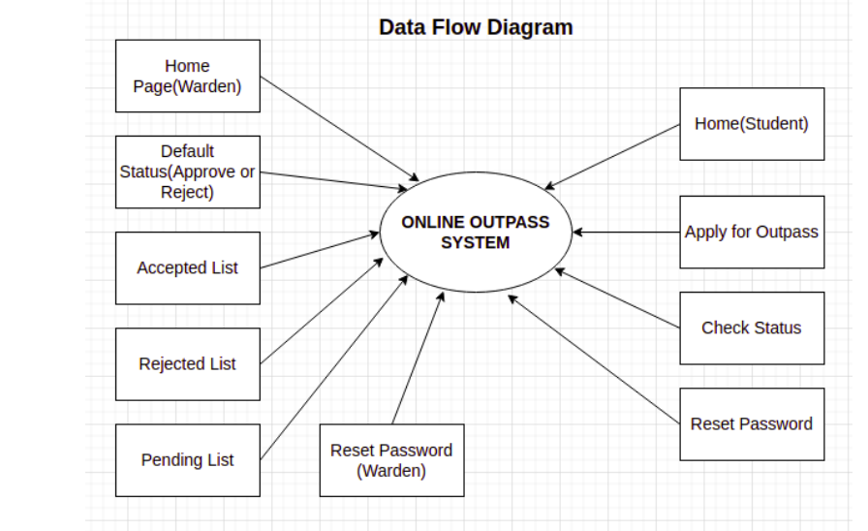
System Architecture

Slide 7
System Deployment Approach
HTML (Hypertext Markup Language): HTML is a markup language used for creating the structure and content of web pages. It provides a set of tags and elements that define the different components of a web page, such as headings, paragraphs, images, links, tables, and forms.
CSS (Cascading Style Sheets): CSS is a style sheet language used to describe the presentation and formatting of a document written in HTML. It provides a set of rules and properties that allow developers to control the appearance of web pages, including the layout, colors, fonts, and spacing.
JavaScript: JavaScript is a programming language that enables interactive and dynamic behavior on web pages. It is primarily used for client-side scripting, meaning it runs directly in the user's web browser. JavaScript allows developers to manipulate HTML elements, handle events, create animations, validate forms, and perform various other actions to enhance the user experience.
PHP (Hypertext Preprocessor): PHP is a server-side scripting language designed for web development. It is embedded within HTML code and executed on the server before being sent to the client's browser. PHP enables developers to create dynamic web pages, interact with databases, handle forms, manage sessions, and perform other server-side tasks.
DBMS (Database Management System): A DBMS is a software system that allows users to store, organize, manage, and retrieve data from a database. It provides an interface to interact with databases, ensuring data integrity, security, and efficient data retrieval.

Slide 8
Algorithm & Deployment
Out-Pass system for hostels where students get to take permission of Warden/care taker just by filling up a simple form. The student login’s and fills the out-pass form and waits for the reply from the authorities(caretaker/warden). By default, the status of the out-pass is “pending”. The Warden gets all the Out-pass Applications from students and have the power whether to accept or reject the outpass. Warden/care taker can take further steps of verification and decides whether to approve or reject the Out-pass. If accepted the status is “Approved” or if rejected the status is "rejected" and the status displayed on the student's view-status page. Warden can also able to see the all approved and rejected out-pass details.

Slide 9
THANK YOU

